Slide 1
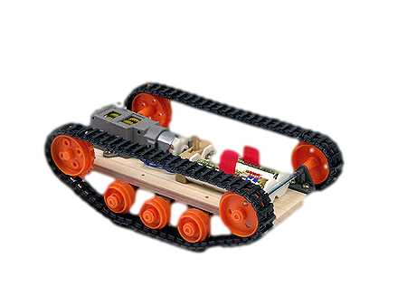
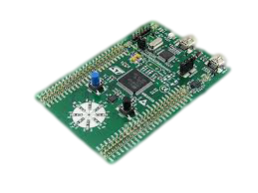
RC Tank
Vinay Rajagopalan
Prasad Hirlikar

Slide 2

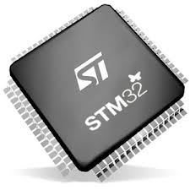
OUR IDEA/MOTIVATION
Build a tank that can be controlled remotely
User controls the tank using command line instructions
A program will be loaded onto the chip to execute the commands
The RC tank will move in the direction(in degrees of rotation)specified by the user
A fully functional prototype can be used for operations that can be life threatening

Slide 3
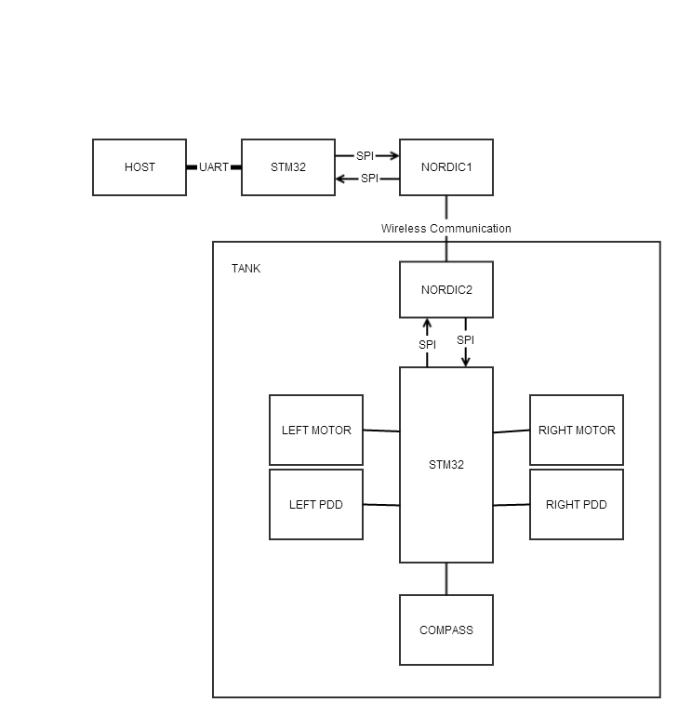
BLOCK DIAGRAM

Slide 4
TECHNICAL PROFILE
Category | Design Objective | Deliverable | Status
Power | Battery life | Based on the usage
Power | Battery availability | Uses commercially available AA batteries or any other batteries
Communication | Tank movement | Device and the host should reliably communicate
User Interface | Command line access | An interface that will help user to communicate with the device
User interface | Device updates and information | Relays the status to the user
Mechanical | Environmental | Device should be run under suitable condition

Slide 5
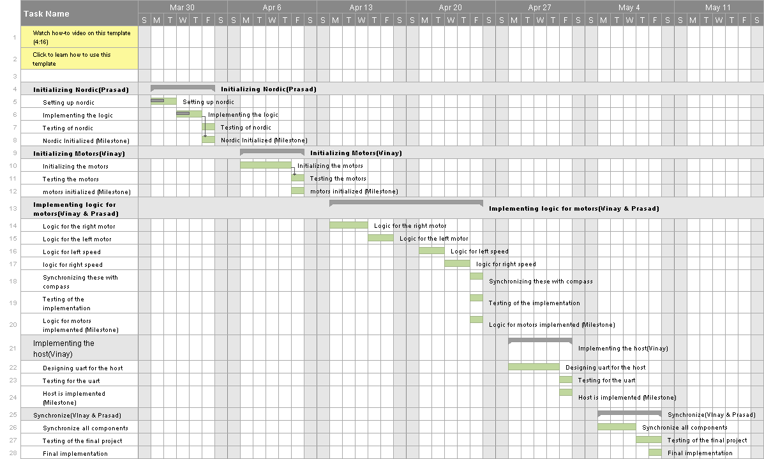
PROJECT TIMELINE

Slide 6
PROJECT TIMELINE
Group Tasks | Sub Tasks | Dates
Initializing Nordic | Setting up nordic | 3/31/2014-4/1/2014
 | Implementing the logic | 4/2/2014-4/3/2014
 | Testing of nordic | 4/4/2014
 | Nordic Initialized (Milestone) | 4/4/2014
Initializing Motors | Initializing the motors | 4/7/2014-4/11/2014
 | Testing the motors | 4/12/2014-4/12/2014
 | motors initialized (Milestone) | 4/12/2014
Implementing logic for motors | Logic for the right motor | 4/13/2014-4/15/2014
 | Logic for the left motor | 4/16/2014-4/17/2014
 | Logic for left speed | 4/18/2014-4/19/2014
 | logic for right speed | 4/21/2014-4/22/2014
 | Synchronizing these with compass | 4/23/2014-4/24/2014
 | Testing of the implementation | 4/25/2014-4/25/2014
 | Logic for motors implemented (Milestone) | 4/25/2014
Implementing the host | Designing uart for the host | 4/28/2014-5/1/2014
 | Testing for the uart | 5/2/2014-5/2/2014
 | Host is implemented (Milestone) | 5/2/2014
Synchronize | Synchronize all components | 5/5/2014-5/8/2014
 | Testing of the final project | 5/9/2014-5/09/2014
 | Final Implementation(Milestone) | 5/09/2014

Slide 7
COMPONENT COST
Component | Quantity | Cost($)
STM32 | 2 | 30
Nordic | 2 | 40
Tank | 1 | 50
Power supply | 6 | 24

Slide 8
THANK YOU !

